Slide 1
Mechatronics
2011
Automatic three wheeler
By Halldór Anderson and Sæmundur Ingi Johnsen

Slide 2
The goal
Building an automatic car
  Using arduino
  Using two servo motors
Function of the car
  Avoid edges
  Avoid objects
  Turn 45° when IR sensors detect an object/edge

Slide 3
Components we used
Arduino Uno
2x SHARP infrared sensor
Bluetooth SMD Module - RN-42
2x servo motors
Breadbord
Battery (9V)

Slide 4
The Design
Desgin
  Round three wheeled car
    Why circular design?
      Good for avoiding objects
  Two IR sensors
    IR sensor #1 detects ground objects
    IR sensor #2 detects edges

Slide 5
The timeline
1. Assembly
1.1 Asembly car
1.2 Placing components
2. Electronics
2.1 Motor
2.2 Arduino
3. Programming
3.1 Motor
2.3 Sensors
3.2 Arduino
3.3 Sensors

Slide 6
PERT

Slide 7
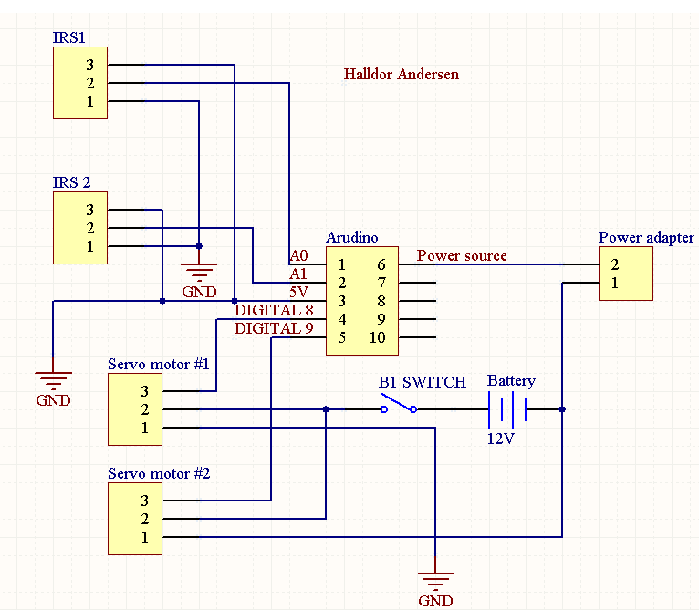
Schematic

Slide 8
Cost estimate
Arduino: $30,00
2x SHARP infrared sensor: $30,00
2x motors: $40,00
Breadboard: $4,00
Battery: $3,00
Bluetooh $15,00
VAT and other fees $140,00
TOTAL: $247,00

Slide 9
Summary
We managed to finish our goal
Some additional features did not work
  Configuring the wireless connectivity
    VIA bluetooth
      Connection between computer and chip OK
      Problem with identification
We could improve the function of the car by adding more IR sensors.
  Detect object/edges on the side

