Slide 1

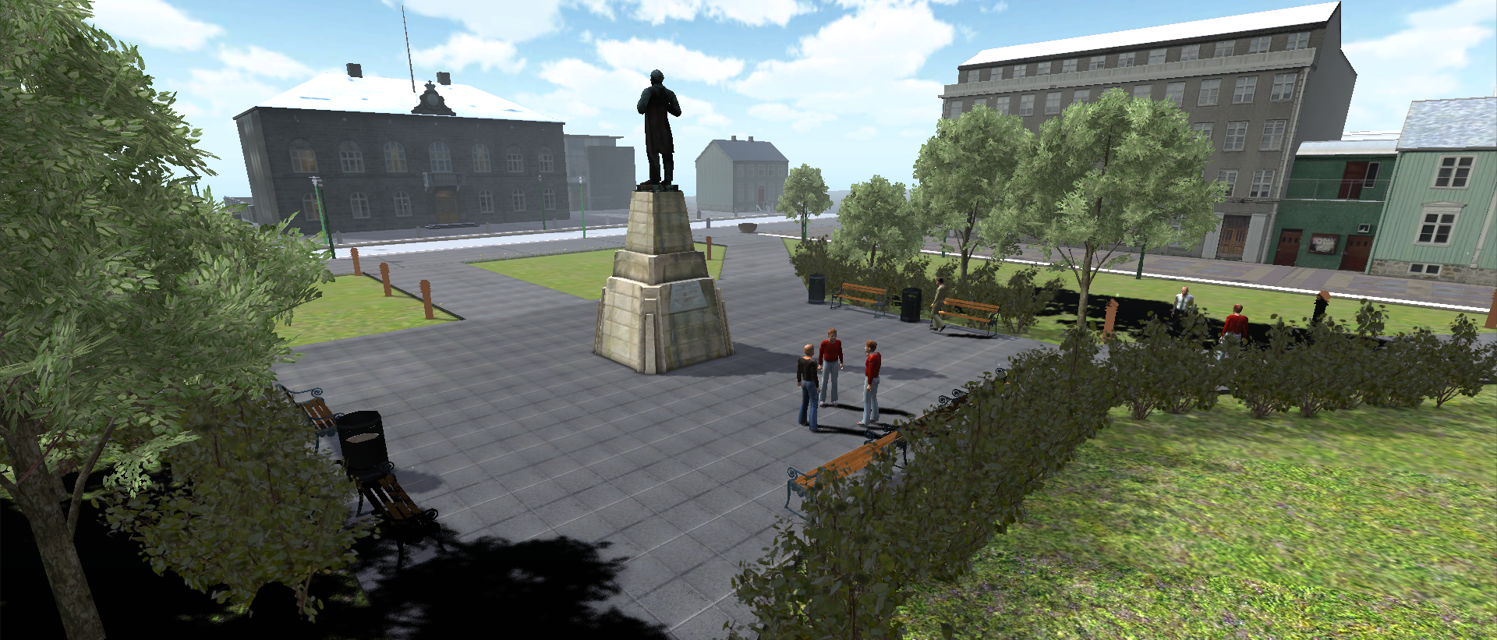
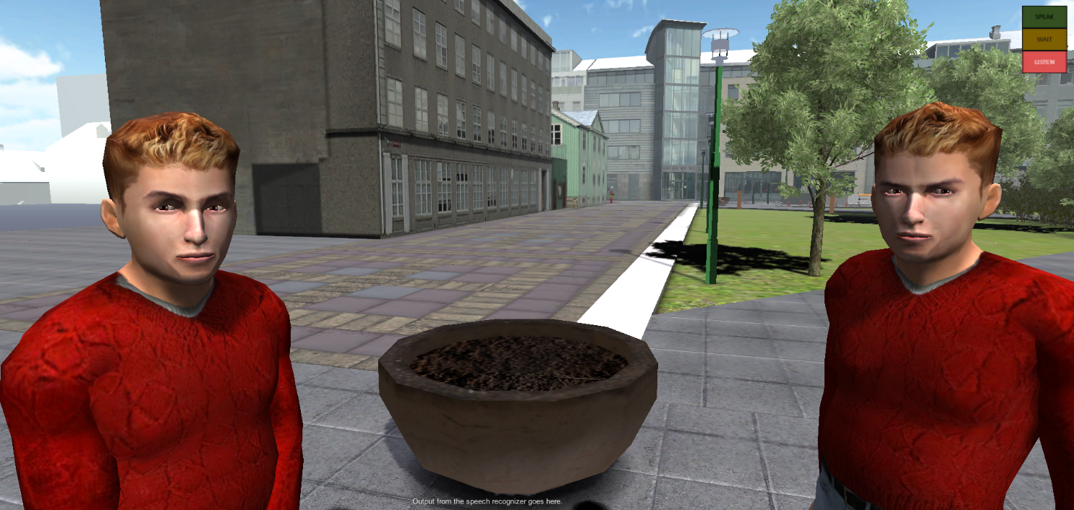
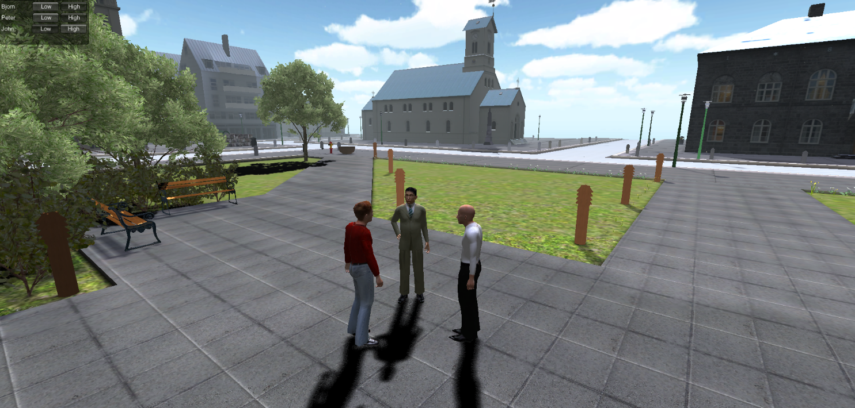






REYKJAVÍK UNIVERSITY
SOCIAL GATHERINGS IN
VIRTUAL REYKJAVÍK
unity-based platform for social agent research. layered approach where basic agents include awareness of social territory and show reactive territorial movement. higher layers include floor management and deliberation of abstract communicative function.
Deliberative / Function Level Intelligence
Understand
Decide
Generate
Social Context / Floor Management
Interactional Track
Reactive Intelligence (Impulsion)
Performative Track
Animation (Mecanim)
Mental State Track
Geometry
continuous reactive motion
A reactive social intelligence layer right above Unity’s animation system ensures that the agents continuously adapt to their environment. The reactive behavior is dictated by social context and inner state. Deliberate social action, such as “request turn to speak” will also generate behavior.
implements proposed unified fml
Implements unified FML specification proposed in (Cafaro et al., 2014), which is organized around different tracks of communicative functions associated with each floor of interaction. Among other things, this separates basic interactional competency (e.g. turn-taking) from domain dependent knowledge.
group conversation with players
The human player is fully integrated into the social environment and can join groups of agents and strike up a conversation, subject to normal rules of turn-taking. The player avatar is simply one of the agents with additional means of control. Some automation is retained in the avatar, e.g. turn-taking behaviors. This is one of the first embodied conversational system in the Icelandic language.
Language training and Dominance research
Virtual Reykjavik is being used to provide an interesting dynamic social environment for Icelandic language and culture training. Students will need to interpret both verbal and nonverbal behavior. The platform is also used to experiment with dominance modeling. Dominant individuals influence the behavior of all group members, who become more submissive. Nonverbal cues of dominance include a more expansive posture.
Hannes Vilhjálmsson¹, Elías Björgvinsson¹, Hafdís Helgadóttir¹, Karl Kristinsson¹, Stefán Ólafsson¹, Angelo Cafaro^{1, 2},
Nicole Krämer³, Jonas Braier³, Philipp Wegge³, Sina Youn³, Claudio Pedica⁴, Birna Arnbjörnsdóttir⁵, Branislav Bédi⁵.
¹CADIA, Reykjavik University, ²CNRS-LTCI, TELECOM ParisTech, ³University of Duisburg-Essen, ⁴Gagarin Ltd., ⁵University of Iceland
3D Models by Páll Heimir Pálsson

